Slide 1
MES – Macierz H lokalna

Slide 2
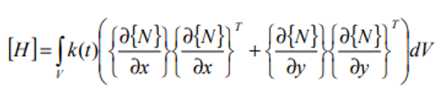
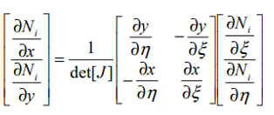
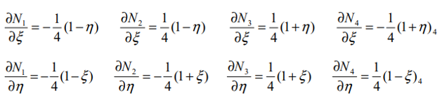
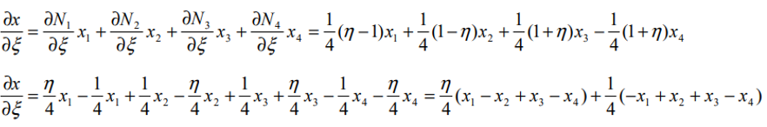

Slide 3
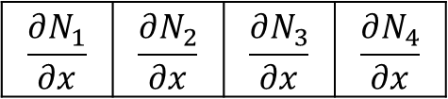
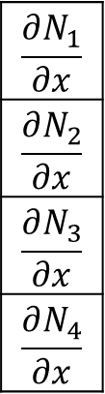
$$\frac{∂N_{1}}{∂x}$$ | $$\frac{∂N_{2}}{∂x}$$ | $$\frac{∂N_{3}}{∂x}$$ | $$\frac{∂N_{4}}{∂x}$$
$$\frac{∂N_{1}}{∂x}$$
$$\frac{∂N_{2}}{∂x}$$
$$\frac{∂N_{3}}{∂x}$$
$$\frac{∂N_{4}}{∂x}$$

Slide 4

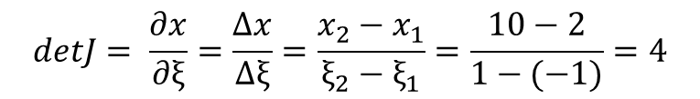










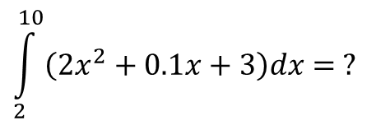


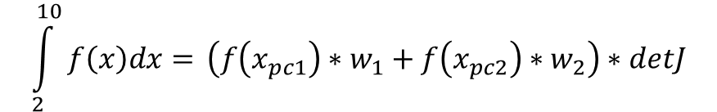
$$\int_{2}^{10}{f\left(x\right)dx=?}$$
$$N_{1}$$
$$N_{2}$$
$N_{1}= \frac{x_{2}− x_{ }}{x_{2}−{ x}_{1}}= \left|\begin{matrix}x_{1}=−1 \\ x_{2}=1\end{matrix}\right|$ = $\frac{1 −{ x}_{ }}{1 −(−1)}$ = $\frac{1}{2}(1−x)$
$N_{2}= \frac{x −{ x}_{1}}{x_{2}−x_{1}}$ = $\left|\begin{matrix}x_{1}=−1 \\ x_{2}=1\end{matrix}\right|$ = $\frac{x −{ (−1)}_{ }}{1 −(−1)}$ = $\frac{1}{2}(1+x)$
$$ξ_{1}=−1$$
$$ξ_{2}=1$$
$N_{1}\left(−0.577\right)= \frac{1}{2}\left(1−\left(−0.577\right)\right)=0.788$
$$N_{1}$$
$$N_{2}$$
$N_{2}\left(−0.577\right)= \frac{1}{2}\left(1+\left(−0.577\right)\right)=0.212$
$$detJ= \frac{∂x}{∂ξ}=\frac{Δx}{Δξ}=\frac{x_{2}−x_{1}}{ξ_{2}−ξ_{1}}=\frac{10−2}{1−(−1)}=4$$
$$x_{1}=2$$
$$\int_{2}^{10}{f\left(x\right)dx=} \left(f\left(x_{pc1}\right){∗w}_{1}+ f\left(x_{pc2}\right){∗w}_{2}\right)∗detJ$$
$$w_{ 1}=4$$
$$w_{2 }=4$$
$$x_{2}=10$$
$x_{pc1}= N_{1}x_{1}$+ $N_{2}$ $x_{2}=0.788∗2+0.212∗10=3.696$
$$\int_{2}^{10}{\left(2x^{2}+0.1x+3\right)dx= ?}$$
$x_{pc2}= N_{1}x_{1}$+ $N_{2}$ $x_{2}=0.212∗2+0.788∗10=8.304$

Slide 5


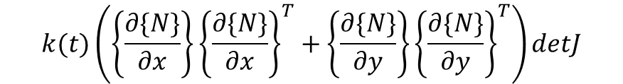














$$k(t)\left(\left\{\frac{∂\{N\}}{∂x}\right\}{\left\{\frac{∂\{N\}}{∂x}\right\}}^{T}+\left\{\frac{∂\{N\}}{∂y}\right\}{\left\{\frac{∂\{N\}}{∂y}\right\}}^{T}\right)detJ$$
$$y$$
$$1$$
$$\begin{aligned}[H]={ (Hpc}_{1}∗w_{1}w_{1}+{Hpc}_{2}∗w_{2}w_{1}+ \\ +{Hpc}_{3}∗w_{2}w_{2}+{Hpc}_{4}{∗w}_{1}w_{2})\end{aligned}$$
$${pc}_{4}$$
$${pc}_{3}$$
$$1$$
$$w_{2 }=1$$
$$−1$$
$$x$$
$${pc}_{1}$$
$${pc}_{2}$$
$${Hpc}_{1}$$
$$−1$$
$$w_{1 }=1$$
$${Hpc}_{2}$$
$$w_{ 1}=1$$
$$w_{2 }=1$$

Slide 6
Praca domowa
Dodanie możliwości wczytywania współrzędnych węzłów z pliku.
Napisanie funkcji liczącej macierz H lokalną.
Zadanie jest uznane za zrobione jeżeli program zwraca wyniki zgodne z testami na UPEL.

